Slide 1
CSP2104 Object-Oriented Programming in C++
Module 13
Using Templates

Slide 2
On the Agenda…
C++ Templates
Another form of polymorphism via “type parameterization”
Create and use function and class templates

Slide 3
Understanding the Usefulness of Function Template
Instead of writing 3 overloaded versions of a given function such as:
Ideally, you could create just one function with a variable name standing in for the type
Good idea, but will not work in C++
int reverse(int x) {
return –x;
}
double reverse(double x) {
return –x;
}
float reverse(float x) {
return –x;
}
VariableType reverse(VariableType x) {
return –x;
}

Slide 4
Function Templates
Function template is an outline for a group of functions that differ in the types of parameters they use
Hence you can find other definitions including:
Template functions are functions that use variable types
A template function is a function that can process a value whose type is known only when the variable is accessed
A group of functions that generates from the same template is often called a family of functions
template <class T>
// T stands for any data type
T reverse(T x) {
return –x;
}

Slide 5
Creating Function Templates Syntax
template <class ParametricType>
ReturnType FunctionName(Argument(s)) {
// code stuff
}
Example:
template <class T>
T reverse(T x) {
return –x;
}

Slide 6
Creating Function Templates
The keyword class in the template definition does not necessarily mean that T stands for a programmer-created class type
Many C++ compilers allow you to replace class with typename in the template definition
When you call a function template, the compiler determines the type of the actual argument passed
double amount = -9.6;
amount = reverse(amount);
The designation of the parameterized type is implicit
The compiler generates code for different functions as it needs, depending on the function calls

Slide 7
Creating Function Templates
Indicates a template is being defined
Indicates T is our formal template
parameter
template <class T>
T findLargest(T x, T y, T z) {
T big;
if (x > y)
big = x;
else
big = y;
if (z > big)
big = z;
return big;
}
Instantiated functions
will return a value of
type T
Instantiated functions required
3 parameters of the same type.
their type will be the actual value
for T
x, y, z and big may be of any type for which the > operator and = have been defined
x, y, z and big must all be of the same type because they are all defined to be the same type, named T

Slide 8
Using Multiple Parameters in Function Templates
class PhoneCall {
friend ostream& operator<<(ostream&, PhoneCall);
private:
int minutes;
public:
PhoneCall(int = 0);
bool operator>(PhoneCall);
};
PhoneCall::PhoneCall(int min) {
minutes = min;
}
ostream& operator<<(ostream& out, PhoneCall call) {
out << “Phone call that lasted “ <<
Call.minutes << “ minutes” << endl;
return out;
}
bool PhoneCall::operator>(PhoneCall call) {
bool isTrue = false;
if (minutes > call.minutes)
isTrue = true;
return isTrue;
}

Slide 9
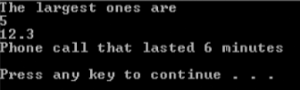
Using Multiple Parameters in Function Templates
int main() {
int a;
double b;
PhoneCall oneCall(4);
PhoneCall anotherCall(6);
PhoneCall c(0);
a = findLargest(3, 5);
b = findLargest(12.3, 5.7);
c = findLargest(oneCall, anotherCall);
cout << “The largest ones are” << endl <<
a << endl << b << endl c << endl;
return 0;
}

Slide 10
Overloading Function Templates
template <class T>
void invert(T& x, T& y) {
T temp;
temp = x;
x = y;
y = temp;
}
template <class T>
void invert(T& x) {
x = -x;
}
You can overload function templates only when each version takes a different argument list, allowing the compiler to distinguish between them

Slide 11
Using More than One Type in a Function Template
template <class T>
void repeatValue(T val, int times) {
for (int x = 0; x < times; ++x)
cout << “#” << (x+1) << “ “ << val << endl;
}
class Store {
friend ostream& operator<<(ostream&, Store);
private:
int storeNumber;
string streetAddress;
string manager;
public:
Store(int = 0, string = “”, string = “”);
};
Store::Store(int num, string add, string mgr) {
storeNumber = num;
streetAddress = add;
manager = mgr;
}
ostream& operator<<(ostream& out, Store store) {
out << “Store #” << store.storeNumber <<
“ Address: “ << store.streetAddress <<
“ Manager Name: “ << store.manager;
return out;
}

Slide 12
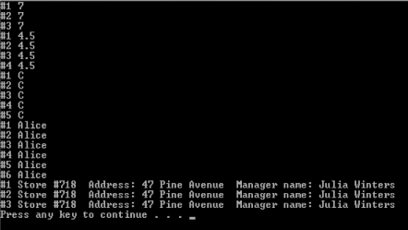
Using More than One Type in a Function Template
int main() {
int a = 7;
double b = 4.5;
char c = ‘C’;
string name = “Alice”;
Store store(718, “47 Pine Avenue”, “Julia Winters”);
repeatValue(a, 3);
repeatValue(b, 4);
repeatValue(c, 5);
repeatValue(name, 6);
repeatValue(store, 3);
return 0;
}

Slide 13
Using Multiple Parameterized Types in a Function Template
template <class T, class U>
void displayAndCompare(T val1, U, val2) {
cout << “First is “ << val1 << “ Second is “ <<
val2 < “ “;
if (val1 > val2)
cout << “First is larger” << endl;
else
if (val1 == val2)
cout << “First and second are equal” << endl;
else
cout << “Second is larger” << endl;
}
class PhoneCall {
friend ostream& operator<<(ostream&, PhoneCall);
private:
int minutes;
public:
PhoneCall(int = 0);
bool operator>(PhoneCall);
bool operator>(int);
bool operator==(PhoneCall);
bool operator==(int);
};

Slide 14
Using Multiple Parameterized Types in a Function Template
bool PhoneCall::operator>(PhoneCall call) {
bool isTrue = false;
if (minutes > call.minutes)
isTrue = true;
return isTrue;
}
bool PhoneCall::operator>(int min) {
bool isTrue = false;
if (minutes > min)
isTrue = true;
return isTrue;
}
bool PhoneCall::operator==(PhoneCall call) {
bool isTrue = false;
if (minutes == call.minutes)
isTrue = true;
return isTrue;
}
bool PhoneCall::operator==(int min) {
bool isTrue = false;
if (minutes == min)
isTrue = true;
return isTrue;
}

Slide 15
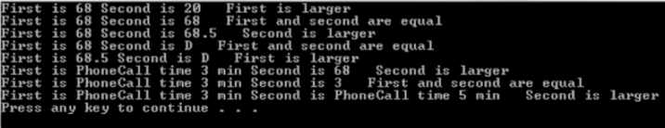
Using Multiple Parameterized Types in a Function Template
int main() {
int a = 68, b = 20;
double c = 68.5;
char d = ‘D’;
PhoneCall oneCall(3), anotherCall(5);
displayAndCompare(a, b);
displayAndCompare(a, 68);
displayAndCompare(a, c);
displayAndCompare(a, d);
displayAndCompare(c, d);
displayAndCompare(oneCall, a);
displayAndCompare(oneCall, 3);
displayAndCompare(oneCall, anotherCall);
return 0;
}
The value of ‘D’ in ASCII
is 68, so ‘D’ and 68 are
considered equal

Slide 16
Explicitly Specifying the Type in a Function Template
When you call a template function, the arguments to the function dictate the types to be used
To override a deduced type
someFunction<char>(someArgument);
Useful when at least one of the types you need to generate in the function is not an argument

Slide 17

Explicitly Specifying the Type in a Function Template
template <class T>
T doubleVal(T val) {
val *= 2;
return val;
}
int main() {
int a = 5;
double b = 6.7;
cout << “Using an integer “ << a <<
“ double is “ << doubleVal(a) << endl;
cout << “Using a double “ << b <<
“ double is “ << doubleVal(b) << endl;
cout << “Using a double “ << b <<
“ converted to an int, double is “ <<
doubleVal<int>(b) << endl;
return 0;
}

Slide 18
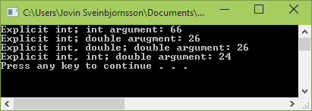
Using Multiple Types Explicitly in a Function Template
#include <iostream>
using namespace std;
template <class T, class U>
T tripleVal(U val) {
T temp = val * 3;
return temp;
}
int main() {
int a = 22;
double d = 8.88;
cout << “Explicit int; int argument: “ <<
tripleVal<int>(a) << endl;
cout << “Explicit int; double argument: “ <<
tripleVal<int>(d) << endl;
cout << “Explicit int, double; double argument: “ <<
tripleVal<int, double>(d) << endl;
cout << “Explicit int, int: double argument: “ <<
tripleVal<int, int>(d) << endl;
system(“pause”);
return 0;
}
Output will be int
Output will be int
Output will be int,
input will be double
Output will be int,
input will be int

Slide 19
Using Class Templates
If you need to create several similar classes, you might consider developing a class template to generate a class in which at least one type is generic or parameterized
Programmers often use the terms class template and template class interchangeably
Technically, you write a class template and it generates a template class

Slide 20
Creating Class Templates
Class template Number
Takes type parameter T
Parameter type T must be specified in the class template as a parameter and where it’s used in the class
When an instance is declared, must explicitly specify the concrete type parameter
template <class T>
class Number {
private:
T theNumber;
public:
Number(T);
void displayNumber();
};
// Implementation goes here
int main() {
Number<int> aNumber(10);
Number<double> bNumber(5.1);
return 0;
}

Slide 21
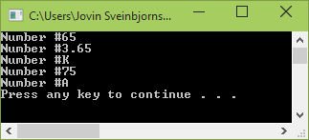
Creating a Complete Class Template
template <class T>
class Number {
private:
T theNumber;
public:
Number(T);
void displayNumber();
};
template <class T>
Number<T>::Number(T n) {
theNumber = n;
}
template <class T>
void Number<T>::displayNumber() {
cout << “Number #”;
cout << theNumber << endl;
}
int main() {
Number<int> anInt(65);
Number<double> aDouble(3.65);
Number<char> aChar(‘K’);
Number<int> aCharAsAnInt(‘K’);
Number<char> anIntAsAChar(65);
anInt.displayNumber();
aDouble.displayNumber();
aChar.displayNumber();
aCharAsAnInt.displayNumber();
anIntAsAChar.displayNumber();
system(“pause”);
return 0;
}

Slide 22
Creating a Complete Class Template
Programmers commonly use template classes for even more generic classes called container classes
Queue: data structure in which elements are removed in the same order they were entered (FIFO)
Stack: data structure in which elements are removed in the reverse order from which they were entered (LIFO)
Linked lists provide a method of organizing stored data base on the logical order of the data

Slide 23
Understanding Container Classes
Many C++ compilers come with class libraries called container classes
A container class is a template class that has been written to perform common class tasks
Manages groups of other classes
A linked list is a chain of objects, each of which consists of at least two parts
The usual components of the object itself
A pointer to another object

Slide 24
Understanding Container Classes – Linked List Example
Memory Address | firstName | lastName | gradePoint | linkingPointer
2000 | Ewa | Shannon | 3.7 | 2500
2500 | George | Thomas | 2.4 | 3000
3000 | Kathy | Salerno | 3.6 | 6000
6000 | Don | Anderson | 2.2 | NULL

Slide 25
Understanding Container Classes
Many link lists provide more than a pointer to the next logical object
May contain a pointer to the previous object, enabling the list to be traverse backward
Procedures must be developed to establish and manage links appropriately in the linked list
Insert new element
Remove an element
Reorder the list
Retrieve and display the objects from a list
In C++, the container class is a list

Slide 26
Creating an Array Template Class
template <class T>
class Array {
private:
T *data;
int size;
public:
Array(T*, int);
void showList();
void showFirst();
};
template <class T>
Array<T>::Array(T *d, int s) {
data = d;
size = s;
}
template <class T>
void Array<T>::showList() {
cout << “Entire list:” << endl;
for (int x = 0; x < size; ++x)
cout << data[x] << endl;
cout << “---------------” << endl;
}
template <class T>
void Array<T>::showFirst() {
cout << “First element is “;
cout << data[0] << endl;
}
class Book {
friend ostream& operator<<(ostream&, const Book&);
private:
string title;
double price;
public:
void setBook(string, double);
};
void Book::setBook(string book, double pr) {
title = book;
price = pr;
}
ostream& operator<<(ostream& out,const Book& book) {
out << book.title << “ sells for $” << book.price;
return out;
}
class Client{
friend ostream& operator<<(ostream&, const Client&);
private:
string name;
double balDue;
public:
void setClient, double);
};
void Client::setClient(string clientName, double pr) {
name = clientName;
balDue = pr;
}
ostream& operator<<(ostream& out, const Client& client) {
out << client.name << “ sells for $” << client.balDue;
return out;
}

Slide 27
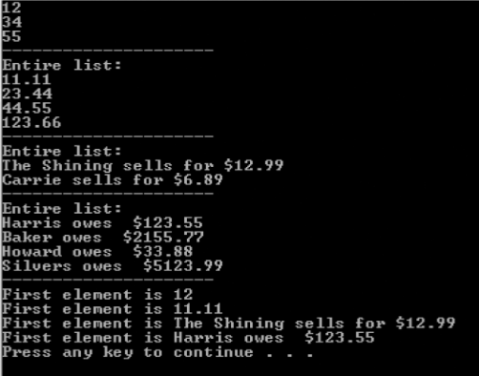
Creating an Array Template Class
int main() {
int arraySize;
// Declare and assign values to four kinds of arrays
int someInts[] = {12, 34, 55};
double someDoubles[] = {11.11, 23.44, 44.55, 123.66};
Book someBooks[2];
someBooks[0].setBook(“The Shining”, 12.99);
someBooks[1].setBook(“Carrie”, 6.89);
Client someClients[4];
someClient[0].setClient(“Harris”, 123.55);
someClient[1].setClient(“Baker”, 2155.77);
someClient[2].setClient(“Howard”, 33.88);
someClient[3].setClient(“Silvers”, 5123.99);
// Calculate size and create Array objects
arraySize = sizeof(someInts)/sizeof(someInts[0]);
Array<int> arrayOfIntegers(someInts, arraySize);
arraySize = sizeof(someDoubles)/sizeof(someDoubles[0]);
Array<doubles> arrayOfDoubles(someDoubles, arraySize);
arraySize = sizeof(someBooks)/sizeof(someBooks[0]);
Array<Book> arrayOfBooks(someBooks, arraySize);
arraySize = sizeof(someClients)/sizeof(someClients[0]);
Array<Client> arrayOfClients(someClients, arraySize);
// Use showList() with each Array
arrayOfIntegers.showList();
arrayOfDoubles.showList();
arrayOfBooks.showList();
arrayOfClients.showList();
// Use showFirst() with each Array
arrayOfIntegers.showFirst();
arrayOfDoubles.showFirst();
arrayOfBooks.showFirst();
arrayOfClients.showFirst();
return 0;
}

Slide 28
Creating an Array Template Class
You might want to add functions to the Array class that could
Display the last element in an array
Display an element in a specified position in the array
Reverse the order of the elements in an array
Sort the elements in an array in ascending or descending order
Remove duplicate elements from an array

Slide 29


